Slide 1
Discrete Mathematics and Its Applications
Kenneth H. Rosen
Chapter 7
Graphs

Slide 2
Definitions
Definition
A graph G = (V , E ) consists of a set V of vertices (also called nodes) and a set E of edges.
Definition
If an edge connects to a vertex we say the edge is incident to the vertex and say the vertex is an endpoint of the edge.
Definition
If an edge has only one endpoint then it is called a loop edge.
Definition
If two or more edges have the same endpoints then they are called
multiple or parallel edges.
Graph Theory
Fall 2019
<number> / 72

Slide 3
Definitions
Definition
Two vertices that are joined by an edge are called adjacent vertices.
Definition
A pendant vertex is a vertex that is connected to exactly one other vertex by a single edge.
Definition
A walk in a graph is a sequence of alternating vertices and edges v₁e₁v₂e₂ . . . v_{n}e_{n}v_{n+1} with n ≥ 0. If v₁ = v_{n+1} then the walk is closed. The length of the walk is the number of edges in the walk. A walk of length zero is a trivial walk.
Graph Theory
Fall 2019
<number> / 72

Slide 4
Definitions
Definition
A trail is a walk with no repeated edges. A path is a walk with no repeated vertices. A circuit is a closed trail and a trivial circuit has a single vertex and no edges. A trail or circuit is Eulerian if it uses every edge in the graph.
Definition
A cycle is a nontrivial circuit in which the only repeated vertex is the first/last one.
Definition
A simple graph is a graph with no loop edges or multiple edges. Edges in a simple graph may be specified by a set {v_{i} , v_{j} } of the two vertices that the edge makes adjacent. A graph with more than one edge between a pair of vertices is called a multigraph while a graph with loop edges is called a pseudograph.
Graph Theory
Fall 2
<number> / 72

Slide 5
Simple Graph
Definition 1. A simple graph G = (V, E) consists of V, a nonempty set of vertices, and E, a set of unordered pairs of distinct elements of V called edges.

Slide 6
A simple graph
Detroit
New York
San Francisco
Chicago
Denver
Washington
Los Angeles
How many vertices? How many edges?

Slide 7
A simple graph
SET OF VERTICES
V = { Chicago, Denver, Detroit, Los Angeles,
New York, San Francisco, Washington }
SET OF EDGES
E = { {San Francisco, Los Angeles}, {San Francisco, Denver},
{Los Angeles, Denver}, {Denver, Chicago},
{Chicago, Detroit}, {Detroit, New York},
{New York, Washington}, {Chicago, Washington},
{Chicago, New York} }

Slide 8
A simple graph
Detroit
New York
San Francisco
Chicago
Denver
Washington
Los Angeles
The network is made up of computers and telephone lines
between computers. There is at most 1 telephone line
between 2 computers in the network. Each line operates
in both directions. No computer has a telephone line to itself.
These are undirected edges,
each of which connects two distinct vertices, and
no two edges connect the same pair of vertices.

Slide 9
A Non-Simple Graph
Definition 2. In a multigraph G = (V, E) two or more edges may connect the same pair of vertices.

Slide 10
A Multigraph
THERE CAN BE MULTIPLE TELEPHONE LINES
BETWEEN TWO COMPUTERS IN THE NETWORK.
Detroit
New York
San Francisco
Chicago
Denver
Washington
Los Angeles

Slide 11
Multiple Edges
Detroit
New York
San Francisco
Chicago
Denver
Washington
Los Angeles
Two edges are called multiple or parallel edges
if they connect the same two distinct vertices.

Slide 12
Another Non-Simple Graph
Definition 3. In a pseudograph G = (V, E) two or more edges may connect the same pair of vertices, and in addition, an edge may connect a vertex to itself.

Slide 13
A Pseudograph
THERE CAN BE TELEPHONE LINES IN THE NETWORK
FROM A COMPUTER TO ITSELF (for diagnostic use).
Detroit
New York
San Francisco
Chicago
Denver
Washington
Los Angeles

Slide 14
Loops
Detroit
New York
San Francisco
Chicago
Denver
Washington
Los Angeles
An edge is called a loop
if it connects a vertex to itself.

Slide 15
Undirected Graphs
pseudographs
multigraphs
simple graphs

Slide 16
Definitions
Definition
A directed graph is a graph in which the edges may only be traversed in one direction. Edges in a simple directed graph may be specified by an ordered pair (v_{i} , v_{j} ) of the two vertices that the edge connects. We say that v_{i} is adjacent to v_{j} and v_{j} is adjacent from v_{i} .
Definition
The degree of a vertex is the number of edges incident to the vertex and is denoted deg(v ).
Definition
In a directed graph, the in-degree of a vertex is the number of edges incident to the vertex and the out-degree of a vertex is the number of edges incident from the vertex.
Graph Theory
Fall 2019
<number> / 72

Slide 17
A Directed Graph
Definition 4. In a directed graph G = (V, E) the edges are ordered pairs of (not necessarily distinct) vertices.

Slide 18
A Directed Graph
SOME TELEPHONE LINES IN THE NETWORK
MAY OPERATE IN ONLY ONE DIRECTION .
Those that operate in two directions are represented
by pairs of edges in opposite directions.
Detroit
New York
Chicago
San Francisco
Denver
Washington
Los Angeles

Slide 19
A Directed Multigraph
Definition 5. In a directed multigraph G = (V, E) the edges are ordered pairs of (not necessarily distinct) vertices, and in addition there may be multiple edges.

Slide 20
A Directed Multigraph
THERE MAY BE SEVERAL ONE-WAY LINES
IN THE SAME DIRECTION FROM ONE COMPUTER
TO ANOTHER IN THE NETWORK.
Detroit
New York
Chicago
San Francisco
Denver
Washington
Los Angeles

Slide 21
Types of Graphs
TYPE EDGES MULTIPLE EDGES LOOPS
ALLOWED? ALLOWED?
Simple graph Undirected NO NO
Multigraph Undirected YES NO
Pseudograph Undirected YES YES
Directed graph Directed NO YES
Directed multigraph Directed YES YES

Slide 22
Degree of a Vertex
The degree of a vertex in an undirected graph is the number of edges incident with it
  except that a loop at a vertex contributes twice to the degree of that vertex
The degree of a vertex v is denoted by deg(v).

Slide 23
Example
c
d
b
a
g
f
e
Find the degrees of all the vertices:
deg(a) = 2, deg(b) = 6, deg(c) = 4, deg(d) = 1,
deg(e) = 0, deg(f) = 3, deg(g) = 4

Slide 24
Adjacent Vertices in Directed Graphs
When (u,v) is an edge of a directed graph G, u is said to be adjacent to v and v is said to be adjacent from u.
(u, v)
initial vertex terminal vertex

Slide 25
Degree of a Vertex
In-degree of a vertex v
  The number of vertices adjacent to v (the number of edges with v as their terminal vertex
  Denoted by deg⁻(v)
Out-degree of a vertex v
  The number of vertices adjacent from v (the number of edges with v as their initial vertex)
  Denoted by deg⁺(v)
A loop at a vertex contributes 1 to both the in-degree and out-degree.

Slide 26
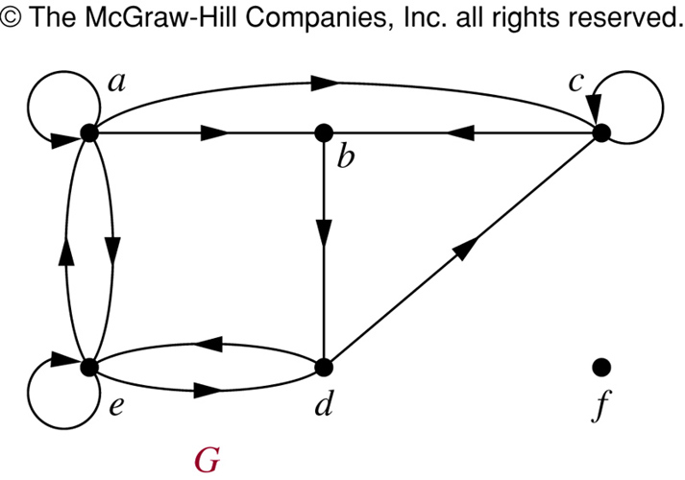
Example

Slide 27
Example
a c
b
e d f
Find the in-degrees and out-degrees of this digraph.
In-degrees: deg⁻(a) = 2, deg⁻(b) = 2, deg⁻(c) = 3, deg⁻(d) = 2, deg⁻(e) = 3, deg⁻(f) = 0
Out-degrees: deg⁺(a) = 4, deg⁺(b) = 1, deg⁺(c) = 2, deg⁺(d) = 2, deg⁺(e) = 3, deg⁺(f) = 0

Slide 28
Degree of a vertex
Definition 1. The degree of a vertex in an undirected graph is the number of edges incident with it, except that a loop at a vertex contributes twice to the degree of that vertex.
c
d
deg( b ) = 6
b
a
g
f
e

Slide 29
Degree of a vertex
Find the degree of all the other vertices.
deg( a ) deg( c ) deg( f ) deg( g )
c
d
deg( b ) = 6
deg( d ) = 1
b
deg( e ) = 0
a
g
f
e

Slide 30
Degree of a vertex
Find the degree of all the other vertices.
deg( a ) = 2 deg( c ) = 4 deg( f ) = 3 deg( g ) = 4
c
d
deg( b ) = 6
deg( d ) = 1
b
deg( e ) = 0
a
g
f
e

Slide 31
Degree of a vertex
Find the degree of all the other vertices.
deg( a ) = 2 deg( c ) = 4 deg( f ) = 3 deg( g ) = 4
TOTAL of degrees = 2 + 4 + 3 + 4 + 6 + 1 + 0 = 20
c
d
deg( b ) = 6
deg( d ) = 1
b
deg( e ) = 0
a
g
f
e

Slide 32
Degree of a vertex
Find the degree of all the other vertices.
deg( a ) = 2 deg( c ) = 4 deg( f ) = 3 deg( g ) = 4
TOTAL of degrees = 2 + 4 + 3 + 4 + 6 + 1 + 0 = 20
TOTAL NUMBER OF EDGES = 10
c
d
deg( b ) = 6
deg( d ) = 1
b
deg( e ) = 0
a
g
f
e

Slide 33
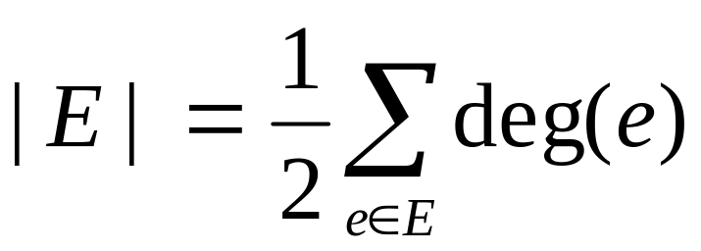
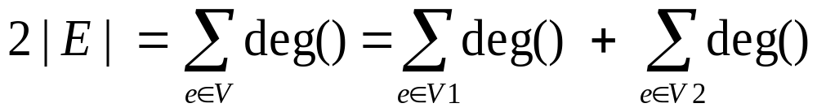
Handshaking Theorem
In an undirected graph
An undirected graph has an even number of vertices of odd degree:

Slide 34
Handshaking Theorem
c
d
b
a
g
f
e
Find the degrees of all the vertices:
deg(a) = 2, deg(b) = 6, deg(c) = 4, deg(d) = 1,
deg(e) = 0, deg(f) = 3, deg(g) = 4
So (2+6+4+1+0+3+4)/2=20/2=10

Slide 35
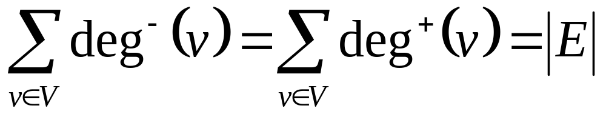
Theorem 3
The sum of the in-degrees of all vertices in a digraph = the sum of the out-degrees = the number of edges.
Let G = (V, E) be a graph with directed edges. Then:

Slide 36
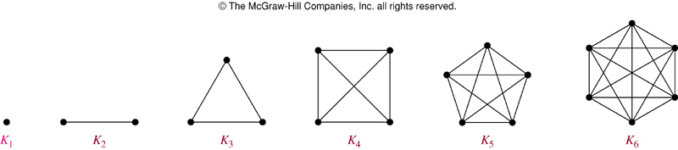
Complete Graph
The complete graph on n vertices (K_{n}) is the simple graph that contains exactly one edge between each pair of distinct vertices.
The figures above represent the complete graphs, K_{n}, for n = 1, 2, 3, 4, 5, and 6.

Slide 37
Cycle
The cycle C_{n} (n ≥ 3), consists of n vertices v₁, v₂, …, v_{n} and edges {v₁,v₂}, {v₂,v₃}, …, {v_{n-1},v_{n}}, and {v_{n},v₁}.
Cycles:
C₃
C₄
C₅
C₆

Slide 38
Wheel
When a new vertex is added to a cycle C_{n} and this new vertex is connected to each of the n vertices in C_{n}, we obtain a wheel W_{n}.
Wheels:
W₃
W₄
W₅
W₆

Slide 39
Definitions
Definition
A graph is connected if there is a walk between every pair of distinct vertices in the graph.
Definition
A graph H is a subgraph of a graph G if all vertices and edges in H are also in G .
Definition
A connected component of G is a connected subgraph H of G such that no other connected subgraph of G contains H.
Definition
A graph is called Eulerian if it contains an Eulerian circuit.
Graph Theory
<number> / 72

Slide 40
Subgraph
Definition 6. A subgraph of a graph G = (V, E) is a graph H = (W, F) where W ⊆ V and F ⊆ E.

Slide 41
C₅ is a subgraph of K₅
K₅
C₅

Slide 42
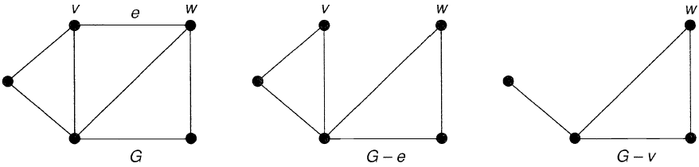
Graph Theoretic Foundations
Subgraphs
Spanning subgraph of G; since V’ = V

Slide 43
Union
Definition 7. The union of 2 simple graphs G₁ = ( V₁ , E₁ ) and G₂ = ( V₂ , E₂ ) is the simple graph with vertex set V = V₁ ∪ V₂ and edge set E = E₁ ∪ E₂ . The union is denoted by G₁ ∪ G₂ .

Slide 44
W₅ is the union of S₅ and C₅
c
b
d
c
c
f
a
e
c
b
d
f
S₅
a
b
d
a
e
e
W₅
a
e
S₅ ∪ C₅ = W₅
C₅

Slide 45
Adjacency Matrix
A simple graph G = (V, E) with n vertices
can be represented by its adjacency matrix,
A, where entry a_{ij} in row i and column j is
1 if { v_{i}, v_{j} } is an edge in G,
a_{ij} =
0 otherwise.

Slide 46
Finding the adjacency matrix
c
c
This graph has 6 vertices
a, b, c, d, e, f. We can
arrange them in that order.
b
d
f
a
a
e
e
W₅

Slide 47
Finding the adjacency matrix
TO
a b c d e f
c
c
FROM
a 0 1 0 0 1 1
b
c
d
e
f
b
d
f
a
a
e
e
W₅
There are edges from a to b, from a to e, and from a to f

Slide 48
Finding the adjacency matrix
TO
a b c d e f
c
c
FROM
a 0 1 0 0 1 1
b 1 0 1 0 0 1
c
d
e
f
b
d
f
a
a
e
e
W₅
There are edges from b to a, from b to c, and from b to f

Slide 49
Finding the adjacency matrix
TO
a b c d e f
c
c
FROM
a 0 1 0 0 1 1
b 1 0 1 0 0 1
c 0 1 0 1 0 1
d
e
f
b
d
f
a
a
e
e
W₅
There are edges from c to b, from c to d, and from c to f

Slide 50
Finding the adjacency matrix
TO
a b c d e f
c
c
FROM
a 0 1 0 0 1 1
b 1 0 1 0 0 1
c 0 1 0 1 0 1
d
e
f
b
d
f
a
a
e
e
W₅
COMPLETE THE ADJACENCY MATRIX . . .

Slide 51
Finding the adjacency matrix
TO
a b c d e f
c
c
FROM
a 0 1 0 0 1 1
b 1 0 1 0 0 1
c 0 1 0 1 0 1
d 0 0 1 0 1 1
e 1 0 0 1 0 1
f 1 1 1 1 1 0
b
d
f
a
a
e
e
W₅
Notice that this matrix is symmetric. That is a_{ij} = a_{ji} Why?

Slide 52
Path of Length n
Definition 1. A path of length n from u to v in an
undirected graph is a sequence of edges
e₁, e₂, . . ., e_{n} of the graph such that
edge e₁ has endpoints x_{o} and x₁ ,
edge e₂ has endpoints x₁ and x₂ ,
. . .
and edge e_{n} has endpoints x_{n-1} and x_{n} ,
where x₀ = u and x_{n} = v.

Slide 53
One path from a to e
c
c
This path passes through vertices f and d in that order.
b
d
f
a
a
e
e
W₅

Slide 54
One path from a to a
This path passes through vertices f, d, e, in that order. It has length 4.
It is a circuit because it begins and ends at the same vertex.
It is called simple because it does not contain the same edge more than once.
c
c
b
d
f
a
a
e
e
W₅

Slide 55
Path of Length n
Definition 3. An undirected graph is called connected if there is a path between every pair of distinct vertices of the graph.
IS THIS GRAPH CONNECTED?
c
c
b
f
a
a
e
e
W₅

Slide 56
Theorem 1
Theorem 1. There is a simple path between every pair of distinct vertices of a connected undirected graph.

Slide 57
Paths of Length r between Vertices
Theorem 2. Let G be a graph with adjacency matrix A with respect to the ordering v₁ , v₂ , . . . , v_{n} . The number of different paths of length r from v_{i} to v_{j} , where r is a postive integer, equals the entry in row i and column j of A^{r}.
NOTE: This applies with directed or undirected edges, with multiple edges and loops allowed.

Slide 58
Definitions
Definition
The complete graph on n nodes, denoted K_{n}, is the simple graph with nodes {1, . . . , n} and an edge between every pair of distinct nodes.
Definition
A graph is called bipartite if its set of nodes can be partitioned into two disjoint sets S₁ and S₂ so that every edge in the graph has one endpoint in S₁ and one endpoint in S₂.
Definition
The complete bipartite graph on n, m nodes, denoted K_{n,m}, is the simple bipartite graph with nodes S₁ = {a₁, . . . , a_{n}} and S₂ = {b₁, . . . , b_{m}} and with edges connecting each node in S₁ to every node in S₂.
Graph Theory

Slide 59
Bipartite Graph
A simple graph is called bipartite if its vertex set V can be partitioned into two disjoint nonempty sets V₁ and V₂ such that every edge in the graph connects a vertex in V₁ and a vertex in V₂ (so that no edge in G connects either two vertices in V₁ or two vertices in V₂).
a b
c d
e
a
d
e
b
c

Slide 60
Graph Theoretic Foundations
Bipartite Graph

Slide 61
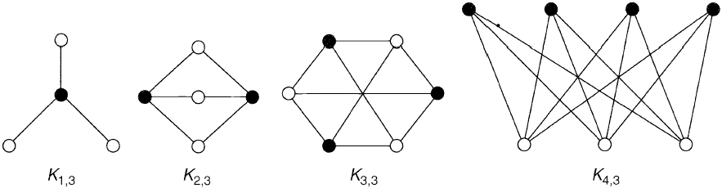
Graph Theoretic Foundations
Bipartite Graph
Complete bipartite graph

Slide 62
Bipartite Graph (Example)
1 2
6 3
5 4
Is C₆ Bipartite?
Yes. Why?
Because:
its vertex set can be partitioned into the two sets V₁ = {v₁, v₃, v₅} and V₂ = {v₂, v₄, v₆}
every edge of C₆ connects a vertex in V₁ with a vertex in V₂

Slide 63
Bipartite Graph (Example)
1
2 3
Is K₃ Bipartite?
No. Why not?
Because:
Each vertex in K₃ is connected to every other vertex by an edge
If we divide the vertex set of K₃ into two disjoint sets, one set must contain two vertices
These two vertices are connected by an edge
But this can’t be the case if the graph is bipartite

Slide 64
Review of Definitions
A walk is a sequence of alternating vertices and edges. A trail is a walk with no repeated edges and a path is a walk with no repeated vertices.
A circuit is a closed trail; a trail that starts and stops at the same vertex.
An Eulerian circuit in a graph is a circuit that contains every edge of the graph.
An Eulerian trail in a graph is a trail that contains every edge of the graph.
A graph is called an Eulerian Graph if it has an Eulerian circuit.
Graph Theory
31 / 72

Slide 65
Euler’s Theorem
Theorem (Euler’s Theorem)
Let G be an connected, undirected graph. G has an Eulerian circuit if and only if every vertex in G has even degree. G has an Eulerian trail if and only if G has exactly two vertices with odd degree.
Basic Algorithm to find an Eulerian Circuit in G :
Let C be an empty circuit in G , assign G₀ = G , and set k = 0. Find any circuit C_{k} in G_{k} .
Merge circuit C_{k} into circuit C .
Construct graph G_{k+1} from G_{k} by removing edges in circuit C_{k}
If C does not contain all edges in G then increment k and go to Step 2.
1
2
3
4
5
Graph Theory
32 / 72

Slide 66
Finding Eulerian Circuits and Trails
Which of the following graphs have an Eulerian circuit? If you can’t find a Eulerian circuit, can you find an Eulerian trail?
A
B
C
D
Graph Theory

Slide 67
Hamiltonian Circuits and Trails
There is another interesting question we can ask about graph: Given a connected graph G , does G have a circuit in which every vertex is visited exactly once?
Such a circuit, if it exists, is called a Hamiltonian circuit. Hamiltonian trails are defined similarly.
It turns out that finding a Hamiltonian circuit or trail in a graph is quite difficult in general, but can be done for many simple graphs.
Graph Theory

Slide 68
Finding Hamiltonian Circuits and Trails
Which of the following graphs have an Hamiltonian circuit? If you can’t find a Hamiltonian circuit, can you find an Hamiltonian trail?
A
B
C
D
Graph Theory

Slide 69



Planar Graphs
Definition
A simple connected graph is planar if it can be drawn in the plane without any edge crossings. Such a drawing is called an embedding of the graph in the plane.
The graph K₄, shown on the left, is planar because it can be drawn in the plane without any edge crossings.
a
b
a
b
d
c
d
c
Graph Theory

Slide 70
Bipartite Graphs
Recall that:
Definition
A graph is called bipartite if its set of nodes can be partitioned into two disjoint sets S₁ and S₂ so that every edge in the graph has one endpoint in S₁ and one endpoint in S₂.
Definition
The complete bipartite graph on n, m nodes, denoted K_{n,m}, is the simple bipartite graph with nodes S₁ = {a₁, . . . , a_{n}} and S₂ = {b₁, . . . , b_{m}} and with edges connecting each node in S₁ to every node in S₂.
Graph Theory

Slide 71







Is K_{3,3} Planar?
a
f
R₂
e
R₃
R₁
d
c
If node b is put in R₁ it can be connected to d and e with no edge crossings but there is no way to connect it to f without a crossing.
Similarly, if b is placed in R₂ we must cross an existing edge to get to d .
Finally, if b is placed in R₃, we must cross an edge to get to e.
Similar investigations with other subgraphs will show that there is no way to draw K_{3,3} without edge crossings, thus K_{3,3} is nonplanar.
Graph Theory

Slide 72
Euler’s Formula
Euler showed that all planer representations of a graph partition the plane into the same number of regions.
Theorem (Euler’s Formula)
If G = (V , E ) is a connected planar graph with r regions, v vertices, and e edges, then v + r − e = 2.
Proof.
Our proof is by induction. Starting with subgraph of G consisting a single vertex, we’ll add edges and vertices (keeping the subgraphs connected) until we construct G . The basis step is
R₁
Here r = 1, v = 1, e = 0 so r + v = e − 2 becomes 1 + 1 = 0 + 2, which is true.
(Continued next slide)
Graph Theory

Slide 73
Euler’s Formula
Proof.
(Continued) For the inductive step, assume that we have a subgraph of G
with e = k edges and that r + v = e + 2 holds. We now draw the the
k + 1st edge. There are two cases:
Both vertices the new edge is incident to are already on the graph. Since the subgraph is connected, this will create a new region. Thus both r and e increase by one so r + v = e + 2 is still true.
A new pendant vertex is introduced with the new edge. This does not increase r but does increase both e and v by one, so r + v = e + 2 continues to hold.
1
2
Since we can continue with these steps until we have constructed G , we conclude that r + v = e + 2 holds for any connected planar graph.
Graph Theory

Slide 74
Degrees of Regions
Definition
The degree of a region of a planar graph is the number of edge traversals required to trace the region’s boundary.
deg(R₁) = 5
deg(R₂) = 7.
R₁ R₂
Question: What is the relationship between the number of edges in a graph and the sum of the degrees of the regions formed by the graph?
Answer: Each edge will be traversed twice, so
r
Σ
2e = deg(R ).
k
k=1
Graph Theory
61 / 72

Slide 75
A Simple Test for Nonplanarity
Question: Suppose G is a connected planar graph with at least three vertices. What is the minimum value of deg(R) for any region created by G ?
Answer: deg(R_{k} ) ≥ 3 for k = 1, . . . , r .
In this case
r
Σ
2e = deg(R ) ≥ 3r = 3(e − v + 2)
k
k=1
so
2e ≥ 3e − 3v + 6
−e ≥ −3v + 6
e ≤ 3v − 6.
Graph Theory
62 / 72

Slide 76
A Simple Test for Nonplanarity
This last result gives a useful test for nonplanarity.
Theorem
Given a a connected planar graph G with v ≥ 3 vertices and e edges, e ≤ 3v − 6.
Thus, if e > 3v − 6 for a connected graph G with v ≥ 3, we know that G
is nonplanar.
Graph Theory

Slide 77
Is K₅ Planar?
Is K₅ planar?
Clearly v = 5 so 3v − 6 = 15 − 6 = 9.
We recall e = C (5, 2) = 10 so e > 3v − 6 and we can conclude that
K₅ is nonplanar.
Graph Theory
64 / 72

Slide 78
Kuratowski’s Theorem
Definition
An elementary subdivision in a graph G replaces any edge {u, v} with a new vertex w and two new edges {u, w} and {w, v}.
Definition
Two graphs are homeomorphic if they can be obtained from the same graph via elementary subdivisions.
Theorem (Kuratowski’s Theorem)
A graph is nonplanar if and only if it contains a subgraph homeomorphic to K_{3,3} or K₅.
Graph Theory

Slide 79
Coloring Graphs
Consider the “map” on the right.
2
What is the fewest number of colors are needed to color this map so that no to adjacent regions have the same color?
1
3
4
6
5
Graph Theory
66 / 72

Slide 80
Coloring Graphs
Consider the “map” on the right.
2
What is the fewest number of colors are needed to color this map so that no to adjacent regions have the same color?
1
3
4
6
5
2
Two colors are not sufficient, but we can do it with three colors.
1
3
4
5
6
Graph Theory
66 / 72

Slide 81
Coloring Graphs
Consider the “map” on the right.
2
What is the fewest number of colors are needed to color this map so that no to adjacent regions have the same color?
1
3
4
6
5
2
Two colors are not sufficient, but we can do it with three colors.
1
3
4
6 5
Question: What is the fewest number of colors that will be sufficient to color any map in the plane?
Graph Theory
66 / 72

Slide 82





Dual Graphs of Maps
The dual graph of a map is a connected simple graph with one vertex corresponding to each region and an edge connecting two vertices if the corresponding regions on the map are adjacent.
2
2
3
1
3
4
1
4
5
6
6
5
Graph Theory
67 / 72

Slide 83
Dual Graphs of Maps
The dual graph of a map is a connected simple graph with one vertex corresponding to each region and an edge connecting two vertices if the corresponding regions on the map are adjacent.
2
2
3
1
3
4
1
4
6 5
6
5
Note that the dual graph of a map will always be planar.
Graph Theory
67 / 72

Slide 84
Coloring a Graph
Definition
The coloring of a simple graph is the assignment of a color to each vertex of the graph so that no two adjacent vertices have the same color.
Definition
The chromatic number of a graph G is the least number of colors needed for a coloring of the graph and is denoted χ(G ).
What is the chromatic number of these graphs?
A
B
C
D
Graph Theory
68 / 72

Slide 85

The Four Color Theorem
The problem of how many colors are needed to color a map is equivalent to asking “what is the largest chromatic number a planar graph can have?”
While first formulated in 1852, this question was not properly answered until 1976, establishing the following Theorem:
Theorem (Four Color Theorem)
The chromatic number of a planar graph is no greater than four.
In that year Appel and Haken presented a proof by cases of the Four Color Theorem that used a computer to check about 1800 separate cases.
Generally accepted as the first use of a computer to prove a theorem.
Postmark from 1994 commemorating the proof of the Four Color Theorem.
Graph Theory

Slide 86
Chromatic Number
What is the chromatic number of the following graphs?
K_{n}: Since each vertex will need its own color, χ(K_{n}) = n.
K_{m,n}: The vertices of K_{m,n} are partitioned into two sets with each edge connecting a vertex in one set to a vertex in the other set. Thus, only two colors are needed, so χ(K_{m,n}) = 2.
C_{n} (the cycle graph with n vertices): The chromatic number depends on the parity of n:
⁾ χ(C_{n} ) = 1 if n = 1
⁾ χ(C_{n} ) = 2 if n is even
⁾ χ(C_{n} ) = 3 if n is odd and n > 1
Graph Theory
70 / 72

Slide 87
Example
Suppose a summer institute offers seven courses. Students can take more than one course.
The following lists show all pairings of courses that have at least one student in common:
Course 1: 2, 3, 4, 7
Course 2: 3, 4, 5, 7
Course 3: 4, 6, 7
Course 4: 5, 6
Course 5: 6, 7
Course 6: 7
Find the fewest number of final exam slots that are needed to avoid any conflicts.
Graph Theory

Slide 88


Example
To solve this problem we construct a graph where each vertex represents a course and an edge between vertices means the corresponding courses have a student in common. We then color the graph to find its chromatic number.
Course 1: 2, 3, 4, 7
Course 2: 3, 4, 5, 7
Course 3: 4, 6, 7
1
7
2
Course 4: 5, 6
Course 5: 6, 7
Course 6: 7
6
3
5
4
Graph Theory
72 / 72

Slide 89




Example
To solve this problem we construct a graph where each vertex represents a course and an edge between vertices means the corresponding courses have a student in common. We then color the graph to find its chromatic number.
Course 1: 2, 3, 4, 7
Course 2: 3, 4, 5, 7
Course 3: 4, 6, 7
1
7
2
Course 4: 5, 6
Course 5: 6, 7
Course 6: 7
6
3
5 4
Since the chromatic number is 4, we conclude that four different final exam periods will be sufficient.
Graph Theory
72 / 72

